Slide 1
Sentimental Analysis on IMDB Reviews

Slide 2
Why was Sentimental Analysis important to me?
Wanted to learn how people use their vocab to praise
What makes a Review Good / Bad
Assumption: Some Keywords make a review Good/Bad

Slide 3
Who provided the Dataset?
Andrew Maas - Currently an Instructor at Stanford
How was the Data Labeled?
Imdb lets the user rate a movie from 1 to 10
All Reviews rated under 4 were marked Negative
All Reviews rated above 7 were marked Positive
Reviews rated 5 or 6 were not used in this dataset.
The data is split evenly

Slide 4
Technologies used
Python Pandas
PySpark
Used as an interpreter
Amazon AWS
Zepl
Paste Bin API

Slide 5
Challenges faced
Merging 25000 text files into a single Excel File
Zepl (not very intuitive)
Exporting the Dataframe as a CSV from Zepl
Workaround found.
Using the Paste Bin API (A Lot of Manual labor)
Learning Regular Expression to Clean up data
To remove punctuations and line breaks

Slide 6
Features Used for Logistic Regression Classifier
from sklearn.feature_extraction.text import CountVectorizer
from sklearn.linear_model import LogisticRegression
from sklearn.metrics import accuracy_score
The NLTK Library was used to Remove Stop Words
This backfired because, the accuracy decreased after I used the NLTK list to remove stop words.
Notes:
Each review was first converted into a numerical value using the SKlearn Vectorizer
Then we create a classifier. The classifier was built using the SKLearn score_accuracy library which provided us with which C value would give the best Accuracy when we train our model
The C parameter of 0.05 was used to train the Final Logistic Regression model.
The parameter C is the the inverse of regularization strength in Logistic Regression.

Slide 7
Features Used for NaiveBayes
from pyspark.ml.feature import Tokenizer, StopWordsRemover, HashingTF, IDF, StringIndexer
from pyspark.ml.feature import VectorAssembler
from pyspark.ml.classification import NaiveBayes

Slide 8
Frequency of popular Positive/Negative Words
Positive Words
excellent
perfect
great
amazing
superb
Negative Words
worst
waste
Awful
poorly
boring
Fun Fact:
The word “Terrific”.
Notes:
The word Teriffic was used a lot more in Positive Reviews however, it was the most used “Positively connotated” word in negative reviews.

Slide 9
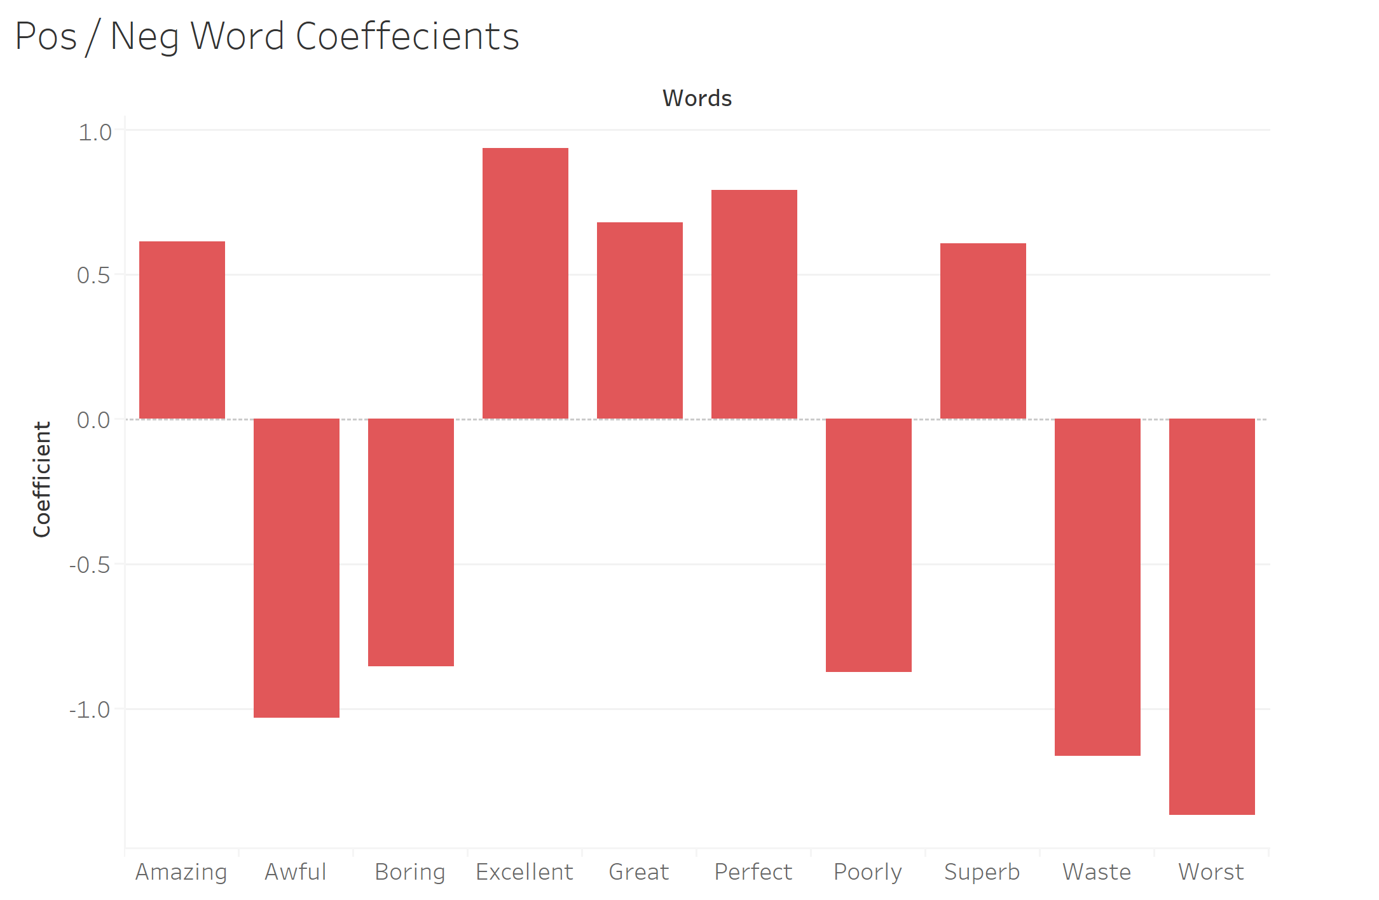
Positive / Negative Word Coefficient
Notes:
Chart comparing the usage of positive words vs negative words.
Given that we had the same number of Positive and Negative Reviews, we cannot assume that most people write Bad Reviews.
However as we see in the following chart that the negative words are used more often within each review. And the word “worst” being the fan favourite, followed by Waste and Excellent.

Slide 10
Negative Reviews Predicted as Positive (Examples)
“The Italian Job" is a caper movie done by the numbers. Riding on the back of every caper cliche, it rises to no particular heights and will be a movie footnote by about the end of the month The biggest problem is that "The Italian Job" possesses no imagination at all. I've seen it all before and done better then. The acting is fine the cinematography is completely acceptable ….”
“OK, it was a "risky" move to rent this flick, but I thought I had nothing to lose.Well, I was wrong. This is, next to "Bloodsurf", the worst "horrormovie" I have ever seen. Crappy actors, crappy technical output, crappy story and so on. The soundtrack though, isn't to bad. That is why I give it a 2 on the vote and not just a 1. And of course the cats are a positive surprise”
“... In this they fail miserably, their undeniable, but rather soft and flabby than steamy, erotic qualities …… Her wide range of facial expressions are the best reason to watch this picture and worth two stars. She endures this basically trashy stuff with an astonishing amount of dignity. I wish some really good parts come along for her”

Slide 11
Positive Reviews Predicted as Negative (Examples)
“For fans of the old cartoon, this is pretty much a continuation of the same, except with a few new characters - and a more insane Cobra Commander. We still have all the old favorites too, but on a personal note, one thing that always irritated me was this "Duke in charge" stuff, when there are tons of other *officers* around instead. The battle sequences are similar to the old series as well; the main trick here seems to be the CGI. It's overall pretty good, if not a little over-the-top.”
“I know what you're saying, "Oh man, Pinochio is not scary!" but this movie goes beyond alot more than a maniacal pinochio. Behind it tells the story of a mother and her daughter who is oddly attached to her doll Pinnochio who seems to talk to her. The only weird thing is that noone else can hear the doll except her. In the end is shocking revelation that, as did I, will shock you. Watch it. Give it a try.”

Slide 12
Results
Bayes Model
Accuracy Rate: 78%
Logistic Regression Model
Accuracy Rate: 89%
Notes:
Each review was first converted into a numerical value using the SKlearn Vectorizer
Then we create a classifier. The classifier was built using the SKLearn score_accuracy library which provided us with which C value would give the best Accuracy when we train our model
The C parameter of 0.05 was used to train the Final Logistic Regression model.
The parameter C is the the inverse of regularization strength in Logistic Regression.
Why is the Logistic Regression Model with higher accuracy?

